Slide 1
Where Does MAN’S UNBELIEF In The Creation Week Lead?

Slide 2
Day 1 | Day 2 | Day 3 | Day 4 | Day 5 | Day 6 | Day 7
Light | Division of waters | Dry land, grass, herb, fruit | Sun, moon, stars | Sea and air creatures | Land creatures, man, woman | Rest
APPROACHES:
Atheistic, Word Denying
  Add inconceivable timetables to the Genesis record

Slide 3
Where Can We Fit Millions of Years?
?
Mosaic
Christian
Patriarchal
PRESENT
Timeline of History
CHRIST
CREATION
|genealogies|
Millions of years
Day 1 | Day 2 | Day 3 | Day 4 | Day 5 | Day 6 | Day 7

Slide 4
Where Can We Fit Millions of Years?
?
MILLIONS OF YEARS BETWEEN
GENESIS 1:1 AND 1:2
CREATION
GAP
Day 1 | Day 2 | Day 3 | Day 4 | Day 5 | Day 6 | Day 7

Slide 5
Day 1 | Day 2 | Day 3 | Day 4 | Day 5 | Day 6 | Day 7
Light | Division of waters | Dry land, grass, herb, fruit | Sun, moon, stars | Sea and air creatures | Land creatures, man, woman | Rest
APPROACHES:
Atheistic, Word Denying
  Gap Theory
    Faulty proof-texts
    Violates 1 Peter 4:11
    Who was the first man
    (1 Cor. 15:45-47)?
    Where did death come from
    (1 Cor. 15:21, 22)?

Slide 6
Where Can We Fit Millions of Years?
?
REVEALED TO MOSES IN
SEVEN DAYS
CREATION
Revelation Day
Day 1 | Day 2 | Day 3 | Day 4 | Day 5 | Day 6 | Day 7

Slide 7
Day 1 | Day 2 | Day 3 | Day 4 | Day 5 | Day 6 | Day 7
Light | Division of waters | Dry land, grass, herb, fruit | Sun, moon, stars | Sea and air creatures | Land creatures, man, woman | Rest
APPROACHES:
Atheistic, Word Denying
  Revelation-Day Theory
    Adds to the Scriptures
    Ignores words “God made”
    (1:7, 16, 25)
    Violates Exodus 31:17

Slide 8
Where Can We Fit Millions of Years?
?
SPREAD
MILLIONS OF YEARS
TO EACH DAY
CREATION
Day-Age
Day 1 | Day 2 | Day 3 | Day 4 | Day 5 | Day 6 | Day 7

Slide 9
Day 1 | Day 2 | Day 3 | Day 4 | Day 5 | Day 6 | Day 7
Light | Division of waters | Dry land, grass, herb, fruit | Sun, moon, stars | Sea and air creatures | Land creatures, man, woman | Rest
APPROACHES:
Atheistic, Word Denying
  Day-Age Theory
    Then millions of years of light and darkness
    Grass, herbs, fruit trees existed millions of years before the sun
    Contradicts the way the Sabbath day was identified (Ex. 20:8-11)

Slide 10
Where Can We Fit Millions of Years?
?
SPREADS
MILLIONS OF YEARS
BETWEEN EACH DAY
CREATION
MULTIPLE GAP
Day 1 | Day 2 | Day 3 | Day 4 | Day 5 | Day 6 | Day 7

Slide 11
Day 1 | Day 2 | Day 3 | Day 4 | Day 5 | Day 6 | Day 7
Light | Division of waters | Dry land, grass, herb, fruit | Sun, moon, stars | Sea and air creatures | Land creatures, man, woman | Rest
APPROACHES:
Atheistic, Word Denying
  Multiple Gap Theory
    Ignores: “so the evening and the morning were the ‘x’ day” and “then” (Gen. 1:5, 8, etc.)
    Adam lived through days 6 & 7
    (Gen. 1:26, 27; 5:1-3; Lk. 3:38)
    Evolutionary chronological problems remain

Slide 12
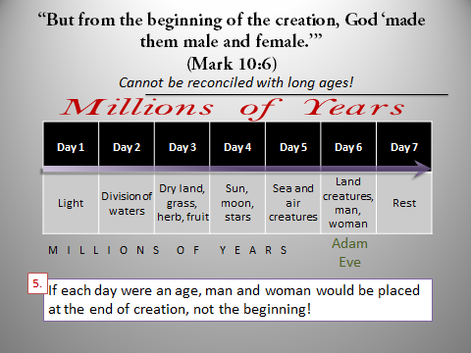
Literal-Day Approach
  Is what is explicitly taught in Genesis 1 “morning and evening”
  Is what Jesus verified (Mk. 10:6)
  Apostles implied (Rom. 1:20; Heb. 9:26)

Slide 13
THE BEGINNING OF CREATION:
Is a test to our faith in an era of unbelief
  No greater faith than believing in the virgin birth, resurrection of Christ on third day, etc.

Slide 14
THE BEGINNING OF CREATION:
Is a test to our faith in an era of unbelief
Is a test to our pride
  Your credibility and research may be cast into “Nebuchadnezzar’s furnace” (Dan. 3:12-18)

Slide 15
THE BEGINNING OF CREATION:
Displays the power of God which explains all other miracles in the Bible
Rejection of this section reveals mankind’s rebellion against the authority of God’s word (cf. Jn. 3:12; 5:46, 47)

